Slide 1


The safe, wise and secure use of digital tech by Nepali migrants and their families: advice for those with little experience of using digital technologies
Source: Tim Unwin
Facilitated by the UNESCO Chair in ICT4D with migrant communities in Nepal as a contribution to WP9 of the MIDEQ Hub

Slide 2
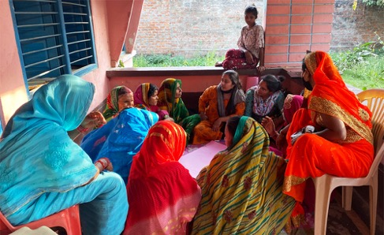
Overall aim of this training
Migrants’ wives in Nepal discussing the impact of migration (Source: Anita Ghimire)
To provide migrants and their families who have little experience of digital tech with a basic introduction to its safe, wise and secure use, so that they can benefit appropriately from their use and enhance the lives of migrant communities.

Slide 3
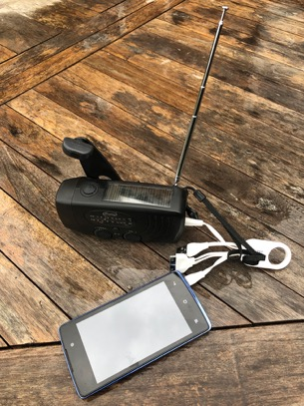
What are digital technologies?
Devices and systems powered by electricity that are used to share and store information
Some examples
  Radios
    One way transmission of information
  Basic mobile phones
    To make phone calls and share messages
  Internet
    A globally connected system of information (data)
  “Smart-phones”
    Phones that can be used to connect to the Internet
  Tablets and Computers (Laptops and Desktops)
    More powerful and bigger devices for storing and sharing more information (data) on bigger screens
Solar powered and wind-up radio and battery charger
Source: Tim Unwin

Slide 4
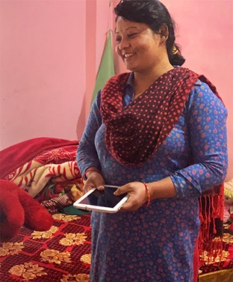
The positive potential of digital tech
Helping us to connect with family
Sharing useful information with friends
  News
  How to get a job
Gaining access to services (such as health, welfare and employment) provided by
  Governments
  Companies
  NGOs
For when we are in trouble: rescue and repatriation
Managing our money and sending some of it home
Language and translation
Finding out where we are
And much more…
Migrant’s wife proudly showing off the tablet sent to her by her husband (Source: Anita Ghimire)

Slide 5
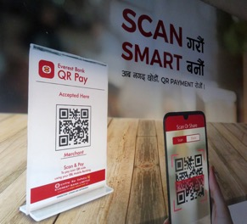
But to take advantage of all this, it is essential to use digital tech safely, wisely, and securely – all linked together
Source: Tim Unwin
Remember that digital tech can also be used deliberately or accidentally to cause many harms

Slide 6
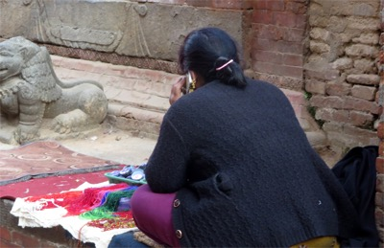
The positives of digital tech can only be realised if…
Migrants and their families have basic “digital literacy”
  Knowing how to use digital tech
And use digital tech:
  Safely
    Ensuring safe practices are used
  Wisely
    Using digital tech for appropriate purposes
  Securely and privately
    Making sure use of digital tech is as secure and private as possible
Source: Tim Unwin

Slide 7

1. Need to begin with basic use of digital tech
Source: Tim Unwin
We can do much more with digital tech if only we knew how! Everyone can learn how to be tech savvy!

Slide 8
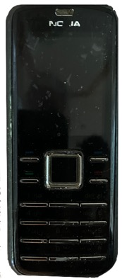
Using a basic mobile phone
Phones enable you to connect by voice or text to family and friends
But remember that everything you use a digital phone for can be traced
  So use it wisely and carefully
It requires electricity, so remember to charge it up
  There are many ways of doing this
You need to be connected to a network
  Having an account (with a SIM card) and a supplier
  Ensure you are within coverage area of your supplier
Basic Nokia phone
Source: Tim Unwin

Slide 9
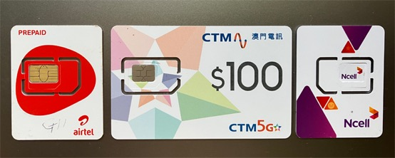
Need to connect to a Network: SIM Cards
SIM cards
  Enable you to connect to a network
Different companies and networks
  Charge different amounts
  Offer different services
Payment
  Prepaid (pay in advance as needed)
  Contract (usually monthly charged to a bank account)
Need to choose company that will best suit your needs
SIM cards
Source: Tim Unwin
(Note: SIM means Subscriber Identity Module)

Slide 10
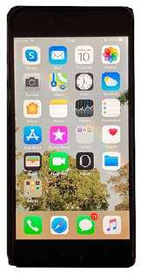
Using smart-phones
Smart-phones enable you to be connected to the Internet
  As long as you are within the network coverage area of your supplier
  But they are more expensive to buy and use
Can still be used for basic calls and text
Also can have many apps (applications) that run on them to do things
  Some free, but many need to be paid for
Typical apps and platforms
  Social media and messaging (such as WhatsApp, Facebook, Viber, TikTok)
    For communicating and sharing text, images, audio and video
  Games
  Watching films
  Making payments
  Accessing platforms and apps such as
    Such as DOFE Baideshik Rojgar, and https://pardesi.org.np
Smartphone
Source: Tim Unwin

Slide 11
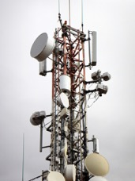
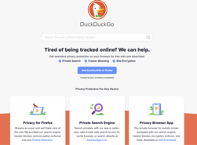
Connecting to the Internet
What is the Internet (or Net)?
  A global system of connected computers that you can access when you are “online”
What is the World Wide Web (or Web)?
  The pages and information you see when you connect to the Internet
Connectivity through mobile networks and WiFi
    Mobile data package
    Using WiFi (but remember data security issues)
      Public (sometimes free as in airports) and private WiFi networks
Searching the web using Browsers
  Popular such as Chrome (Google), Safari, Firefox, DuckDuckGo
Interacting: using voice, text, video through applications (apps)
Mast for mobile connectivity
Source: Tim Unwin

Slide 12

Digital literacy and information literacy
Digital literacy (see also GSMA guide):
  Knowing how to use hardware effectively
    The full potential of a phone
    Screens
    Keyboards
    Other uses – such as a torch or compass
  Using software appropriately
    Learning how to use different apps
      Understanding and changing the settings
    Learn how to use social media (Facebook, X/Twitter) and messaging apps (WhatsApp, Signal) safely and securely
Information literacy:
  How to know if information is true or not
  Is the information genuine and authentic?

Slide 13
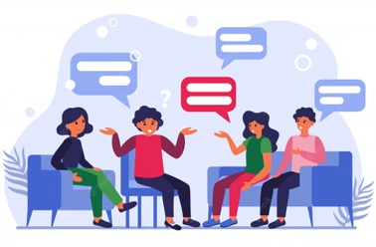
Discussion

Slide 14

2. The safe use of digital technologies
Source: Tim Unwin
“Using digital tech so you are not at risk of harm or of harming others”

Slide 15
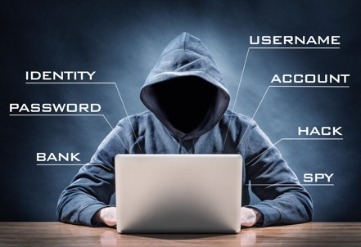
Key elements to remaining safe: knowing the potential harms
Knowing the potential harms
  Being tracked
  Online abuse and harassment
  Bullying
  Scams and losing money or documents
  What we give to companies by using digital
  If it seems too good to be true, it probably is…
But don’t be too afraid of them
  Act wisely, safely and securely
    So that you can truly benefit from digital tech
https://www.oceanpointins.com/ri-business-insurance/cyber-liability-insurance/8-common-hacking-techniques/

Slide 16
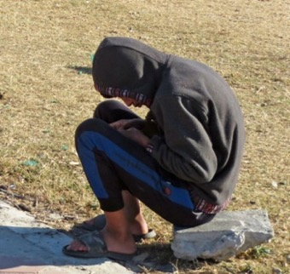
Key elements to remaining safe: behaving safely
Behaving safely online
  Learn about the tech and apps you want to use
  Never share anything that could harm you or others
  Try not to provoke others
  Don’t let yourself be persuaded to join an app/platform if you don’t want to, or are unsure about it
  Don’t write or say something online that you would not say to someone’s face
  Don’t click on a website link you aren’t sure about
    Check link begins with “https” rather than just “http”
  Always try to protect the most vulnerable (e.g. children)
  Beware of “deep fakes”: they are not what they appear to be
Source: Tim Unwin

Slide 17
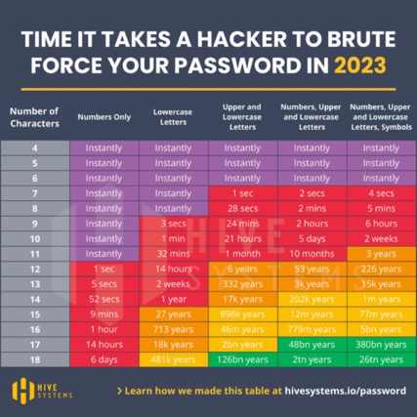

Key elements to remaining safe: technical
Always report (to app owners and police/authorities) as soon as you can:
  Phishing: tricking you to do something wrong
    Never click a link you are unsure of
  Hacking: compromising a digital system
  Scams: many varieties of fraud – often to access your money, documents or identity
    Watch out for scams using QR (Quick Response) codes
Authentication
  Passwords (keep them complex and unique for each app)
    Longer than 10 characters and using numbers, symbols, and upper- and lower-case letters
  Biometric authentication (fingerprints, face)
  Multi-factor (several pieces of evidence)
  Device recognition (securing your devices from malicious actors)
  Be sure you know who you are really interacting with online or on social media

Slide 18
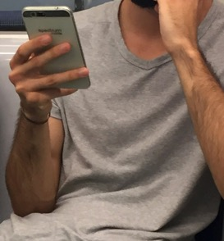
Top tips when you begin using mobile phones: always do these
“Factory reset” a second-hand phone that you receive or give. This will erase any existing information/data on it.
Keep your apps and operating systems updated with the latest versions
Only ask someone you really trust to help set your SIM card settings or add money to an account
Never share your passwords (and use strong ones)
Get a physical case and screen protector for your phone
Minimise the amount of personal information you keep on your phone in case it is stolen or lost.
Source: Tim Unwin

Slide 19
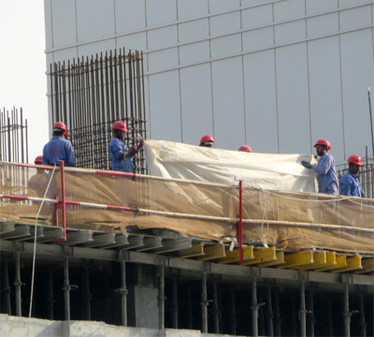
Remember the cultural contexts where you use digital tech
Know the local cultural and legal contexts where you are living as a migrant
In some countries it is wise not to take photos of:
  Government buildings and military sites
  Aircraft or airports
  Incidents such as accidents
Remember to respect other people’s privacy and don’t take photos of them without permission
  Especially women and families
Keep your selfies to yourself
Migrant labour in Dubai:
Source: TimUnwin

Slide 20
Discussion

Slide 21

3. Using digital tech wisely
Source: Tim Unwin
“Using digital tech with good judgement and knowledge”

Slide 22
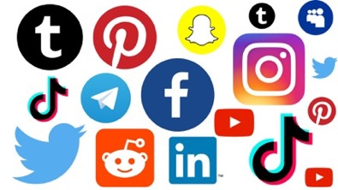
Key elements to wise use of digital tech: what to do
Do use it productively for what you want to use it for
  and not for what companies or governments want you to use it for
Do be very careful about what you post online
Do learn properly how to use the tech and apps you have
  Read the terms and conditions
  Adjust the settings
Do remember that everything “posted” remains online somewhere for ever
Do be thoughtful and polite on social media
Do take time away from digital tech
Do think about creating multiple identities/e-mails (with a separate one for purchases)
  And keeping a “clean” phone for emergencies

Slide 23

Key elements to wise use of digital tech: what not to do
Don’t post anything you would not want everyone to see
  Who can see what you post?
  Check privacy settings
  Never post when you are upset or distressed
Don’t ever respond to messages/links you do not trust
  Especially those pretending to be from your bank
Don’t waste too much time on
  Social media
  Gaming online
  Online gambling
  Digital violence
Don’t waste money
  As with TikTok gifting
Don’t take risks through using digital tech
  As with crypto currency investments
Don’t respond to provocation if you suffer a “troll” attack
  It will only make it worse
Source: Tim Unwin

Slide 24
Discussion

Slide 25

4. The secure use of digital technologies
https://www.smartcitiesworld.net/ai-and-machine-learning/ai-and-machine-learning/ai-expands-capabilities-of-surveillance-and-public-safety-tech
“Using digital tech securely and with privacy”
https://www.telegraph.co.uk/news/2018/11/06/chinese-surveillance-grows-stronger-technology-can-recognise/
See also video at https://www.facebook.com/scmp/videos/246038106344865/?t=34

Slide 26
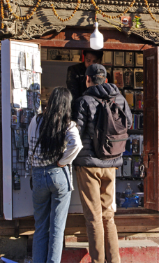
Key elements to secure use of digital tech – social behaviours
Being private online
  Remember that what you post on the Internet is there forever
  Only post if you are sure that you and related others are happy with this
  Never share your passwords with anyone
    Don’t ever share a One-Time Password (OTP) with anyone
  Whenever possible reject all cookies when visiting websites.
Secure and private from whom?
  Governments
    Remember mobile devices can be used for surveillance
  Companies
    Remember that most social media companies make their money from the data you give them for free!
  Other people
    Some are eager to exploit you through digital tech
Source: Tim Unwin

Slide 27
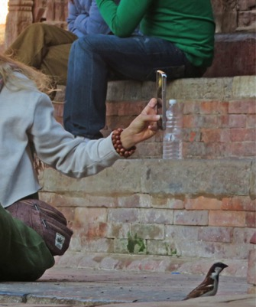
Key elements to secure use of digital tech: practical matters
Keep your software as up-to-date as possible
  The latest versions of apps usually improve security
Turn off as many cookies (permissions) as possible
  Only accept necessary cookies (or reject all)
  So you don’t share all you do online with organisations that you don’t want to
Thing about using free Virtual Private Networks (VPNs) to access the Internet
  These help to hide a user’s digital location and identity and makes them anonymous
Source: Tim Unwin

Slide 28
Discussion

Slide 29

Conclusions: think about
Source: Tim Unwin
is it safe?
is it wise?
is it secure?

Slide 30


Final reminders: being safe, wise and secure
What to do
What not to do
Learn about how to use your digital tech
Create robust passwords
Use multi-factor authentication
Regularly update your apps and operating systems
Be thoughtful and polite on social media
Take time away from digital tech
Don’t share your passwords
Don’t become addicted to digital tech
Don’t respond to messages you do not trust
Don’t waste money you can’t afford on digital tech and social media
Don’t send money or documents online to someone you don’t know
Don’t share anything online you would not want everyone to see

Slide 31
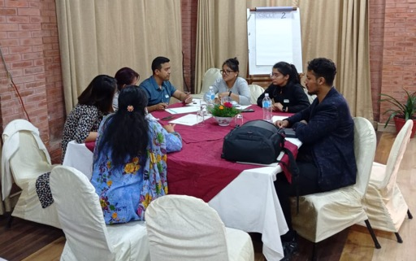
Origins of this training resource (2022-23)
Developed collaboratively with AuraEd, Hamropatro, Helvetas SaMi, NNSM, Pourakhi, PNCC, NIC, NISER, UNESCO Office in Kathmandu, Ujyaalo, Gandaki University, MRC Pokhara, and NEST Pokhara

Slide 32


Funded by UKRI GCRF as part of the MIDEQ Hub (2019—2024)
Together with partner

Slide 33

This work is licensed under a Creative Commons – Attribution-ShareAlike 4.0 International License Creative Commons CC BY-SA 4.0 License. Any part of this document may be reproduced without permission, but with attribution to The UNESCO Chair in ICT4D, Royal Holloway, University of London, and the authors. Please feel free to use and share this information, but kindly respect the copyright of all included works and share any adapted versions of this work.

